Slide 1
1.3 - Graphing Techniques: Transformations
MATH 1550 - Precalculus

Slide 2
Horizontal and Vertical Shifts
In practice, given some function f(x), we tend to simply say:
The transformation f(x – a) shifts the graph to the right a units.
The transformation f(x + a) moves the graph to the left a units.
The transformation f(x) + b shifts the graph up b units
The transformation f(x) – b shifts the graph down b units.

Slide 3
Horizontal and Vertical Shifts
The rationale behind them

Slide 4
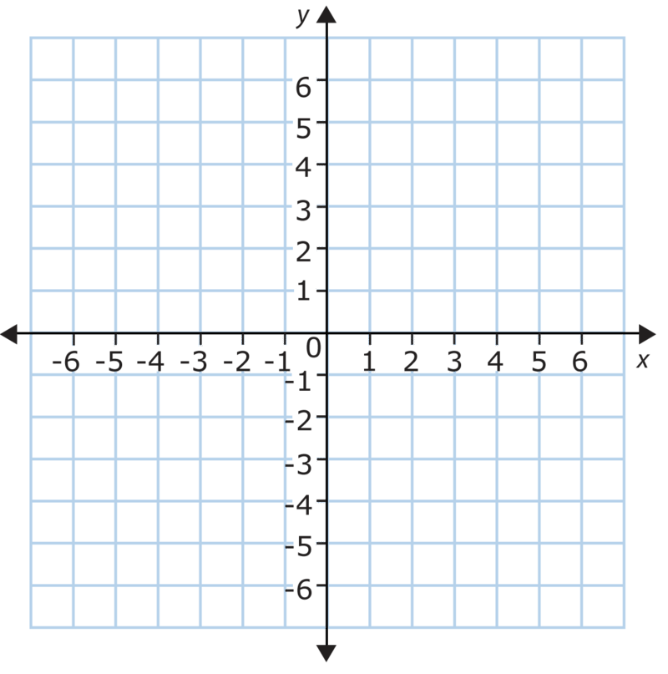
Horizontal Graph Shifts
The logic behind a horizontal shift, y = f(x + a), a units to the left is like so:
We shift the coordinate axes a units to the right.
This makes the graph shift a units to the left.
Ex: Graph g(x) = (x + 3)² from
f(x) = x²

Slide 5
Horizontal Graph Shifts
Likewise, the logic behind a horizontal shift, y = f(x – a), a units to the right is like so:
We shift the coordinate axes a units to the left. (Hence the minus)
This makes the graph shift a units to the right.
Ex: Graph g(x) = (x – 4)² from f(x) = x²

Slide 6
Vertical Graph Shifts
A vertical shift of f(x) up a units is given by y = f(x) + a
This is much more “intuitive” than the horizontal shift.
This is a direct consequence of how we tend to write functions.
We could rewrite y = f(x) + a as y – a = f(x)
This would shift the coordinate axes down a units like before.
This would cause the graph to move up a units.
Ex: Graph g(x) = x² + 3 from f(x) = x²

Slide 7
Vertical Graph Shifts
Likewise, a vertical shift of f(x) down a units is given by y = f(x) – a
Again, we could rewrite y = f(x) – a as y + a = f(x)
This would shift the coordinate axes up a units.
This would cause the graph to move down a units.
Ex: Graph g(x) = x² – 5 from f(x) = x²

Slide 8
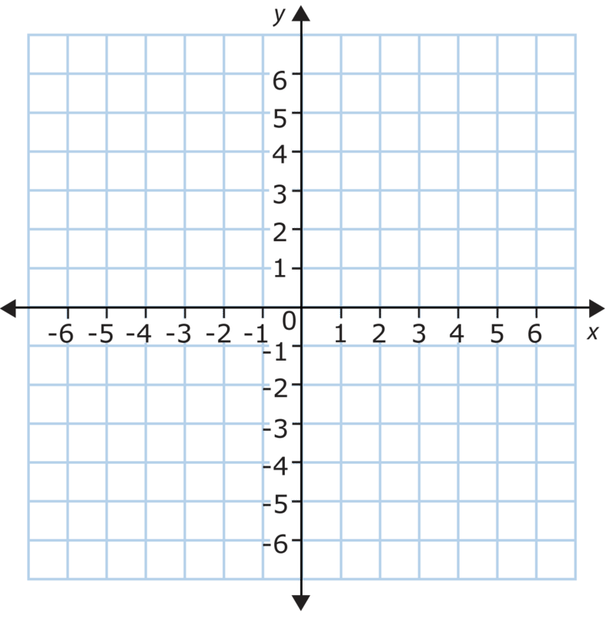

Examples
Graph the equation g(x) = $\sqrt{x+2}$ given that its parent function is f(x) = $\sqrt{x}$.
The + 2 signifies the graph moves to the left 2 units.

Slide 9
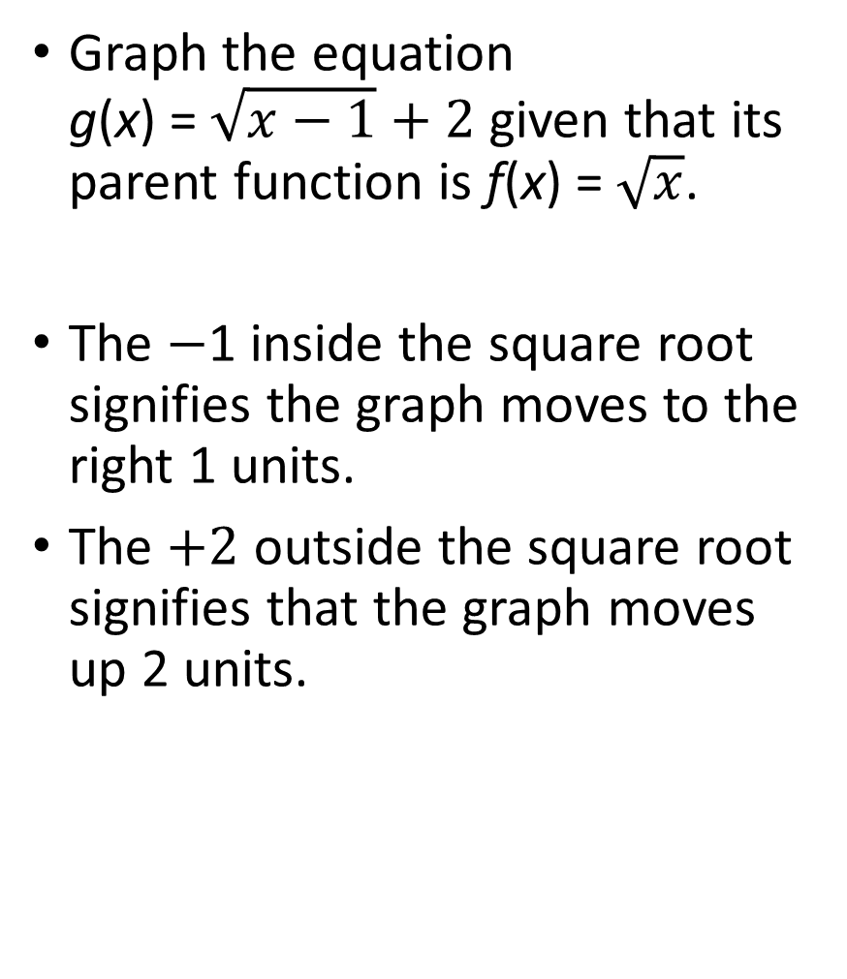
Examples
Graph the equation g(x) = $\sqrt{x−1}+2$ given that its parent function is f(x) = $\sqrt{x}$.
The $−$1 inside the square root signifies the graph moves to the right 1 units.
The $+2$ outside the square root signifies that the graph moves up 2 units.

Slide 10
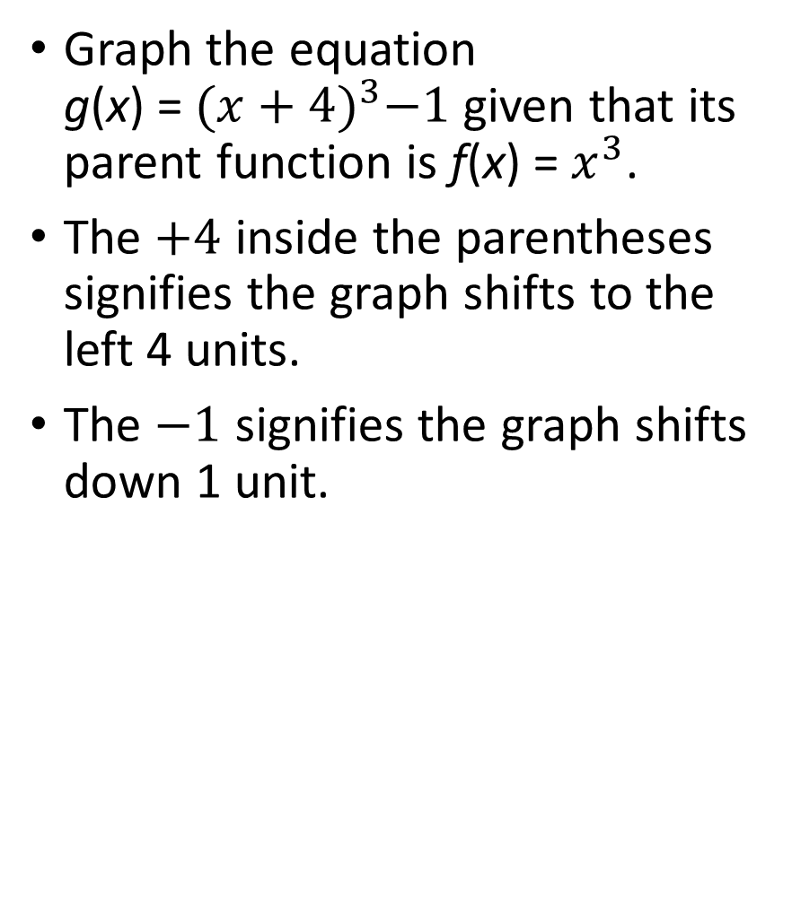
Examples
Graph the equation g(x) = ${(x+4)}^{3}−1$given that its parent function is f(x) =${ x}^{3}$.
The $+4$ inside the parentheses signifies the graph shifts to the left 4 units.
The $−1$ signifies the graph shifts down 1 unit.

Slide 11
Reflection About The Axes
The inner workings

Slide 12
Reflection About The x-axis
Suppose we want to reflect the graph of y = |x| about the x-axis.
This basically means that all positive y-values suddenly become negative.

Slide 13
Reflection About The x-axis
Suppose we want to reflect the graph of f(x) = |x| about the x-axis.
This basically means that all positive y-values suddenly become negative.
In essence, we say that the transformation of f(x) is
g(x) = –|x|

Slide 14
Reflection About The x-axis
In general, reflecting the graph of f(x) across the x-axis is given by g(x) = –f(x).

Slide 15
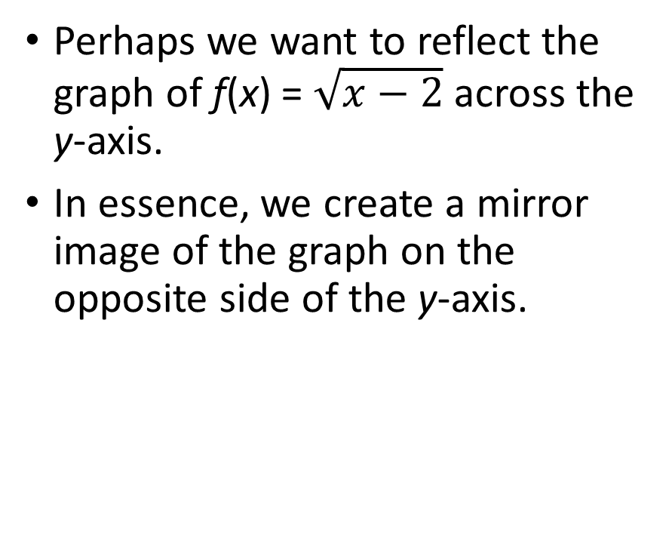
Reflection About The y-axis.
Perhaps we want to reflect the graph of f(x) = $\sqrt{x−2}$ across the y-axis.
In essence, we create a mirror image of the graph on the opposite side of the y-axis.

Slide 16
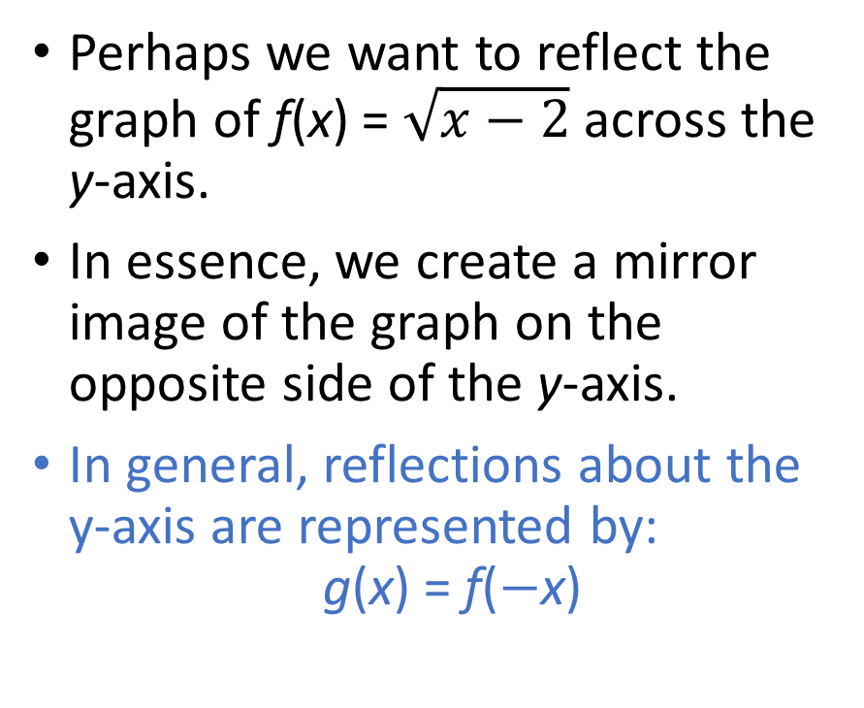
Reflection About The y-axis.
Perhaps we want to reflect the graph of f(x) = $\sqrt{x−2}$ across the y-axis.
In essence, we create a mirror image of the graph on the opposite side of the y-axis.
In general, reflections about the y-axis are represented by: g(x) = f($−$x)

Slide 17
Graph Stretching and Compression
The rationale behind the workings of compression and stretching

Slide 18
Graph Compression and Stretching
In practice, given some function f(x), we tend to simply say:
If 0 < c < 1
The transformation f(cx) stretches the graph horizontally.
The transformation cf(x) shrinks the graph vertically.
If c > 1
The transformation f(cx) shrinks the graph horizontally.
The transformation cf(x) stretches the graph vertically.

Slide 19
Graph Compression and Stretching
It is often much easier to figure out the amount of a vertical stretch or compression than a horizontal stretch or compression.
If possible, attempt to derive an equation from a graph using only a vertical stretch or compression.

Slide 20
Horizontal Compression
Let f(x) be a function, and c be a positive number.
If c > 1, then y = f(cx) is a horizontal compression.
This is because the coordinate axes are what stretches, which causes the graph to get “skinnier”.
Ex: Graph g(x) = (3x)³ from f(x) = x³

Slide 21
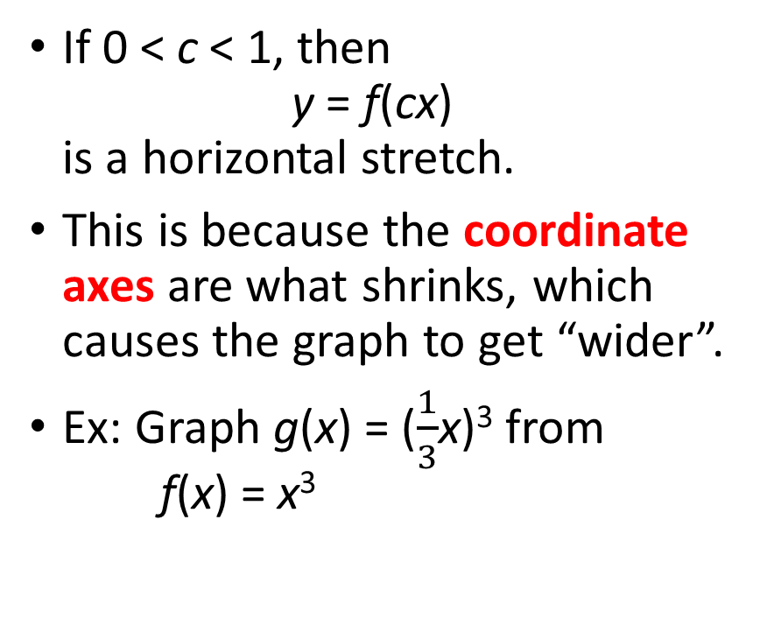
Horizontal Stretch
If 0 < c < 1, then y = f(cx) is a horizontal stretch.
This is because the coordinate axes are what shrinks, which causes the graph to get “wider”.
Ex: Graph g(x) = ($\frac{1}{3}$x)³ from f(x) = x³

Slide 22
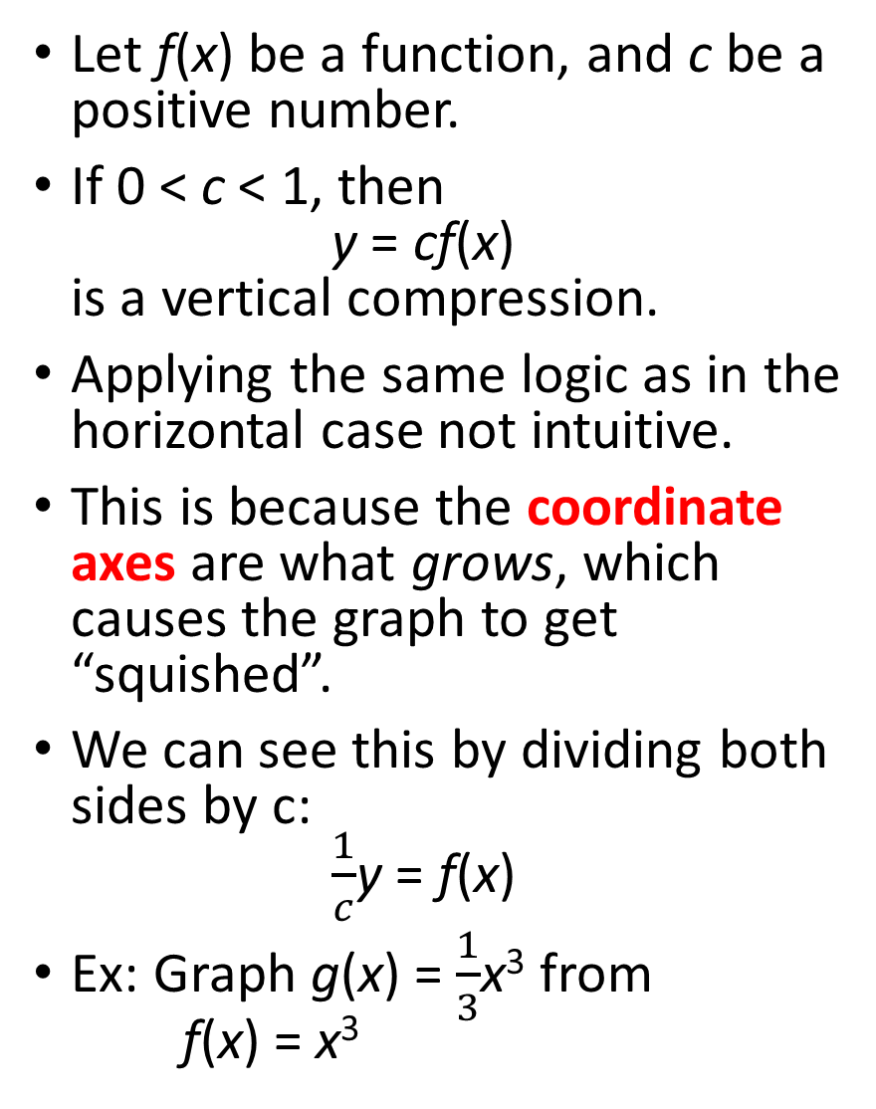
Vertical Compression
Let f(x) be a function, and c be a positive number.
If 0 < c < 1, then y = cf(x) is a vertical compression.
Applying the same logic as in the horizontal case not intuitive.
This is because the coordinate axes are what grows, which causes the graph to get “squished”.
We can see this by dividing both sides by c: $\frac{1}{c}$y = f(x)
Ex: Graph g(x) = $\frac{1}{3}$x³ from f(x) = x³

Slide 23
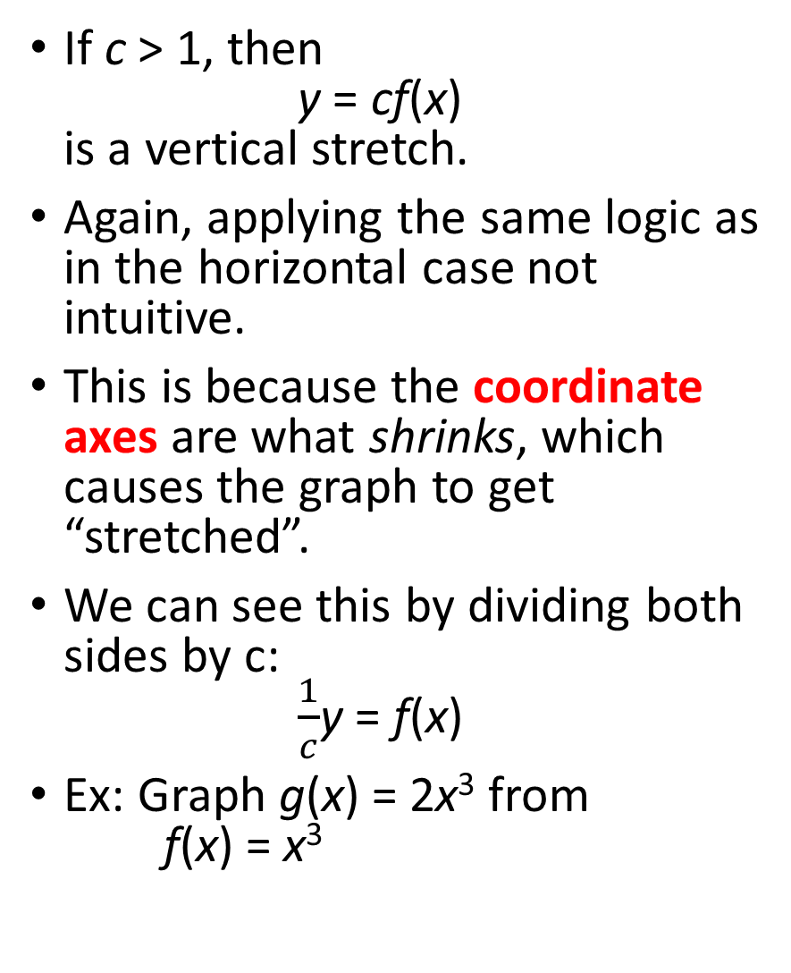
Vertical Stretch
If c > 1, then y = cf(x) is a vertical stretch.
Again, applying the same logic as in the horizontal case not intuitive.
This is because the coordinate axes are what shrinks, which causes the graph to get “stretched”.
We can see this by dividing both sides by c: $\frac{1}{c}$y = f(x)
Ex: Graph g(x) = 2x³ from f(x) = x³

Slide 24
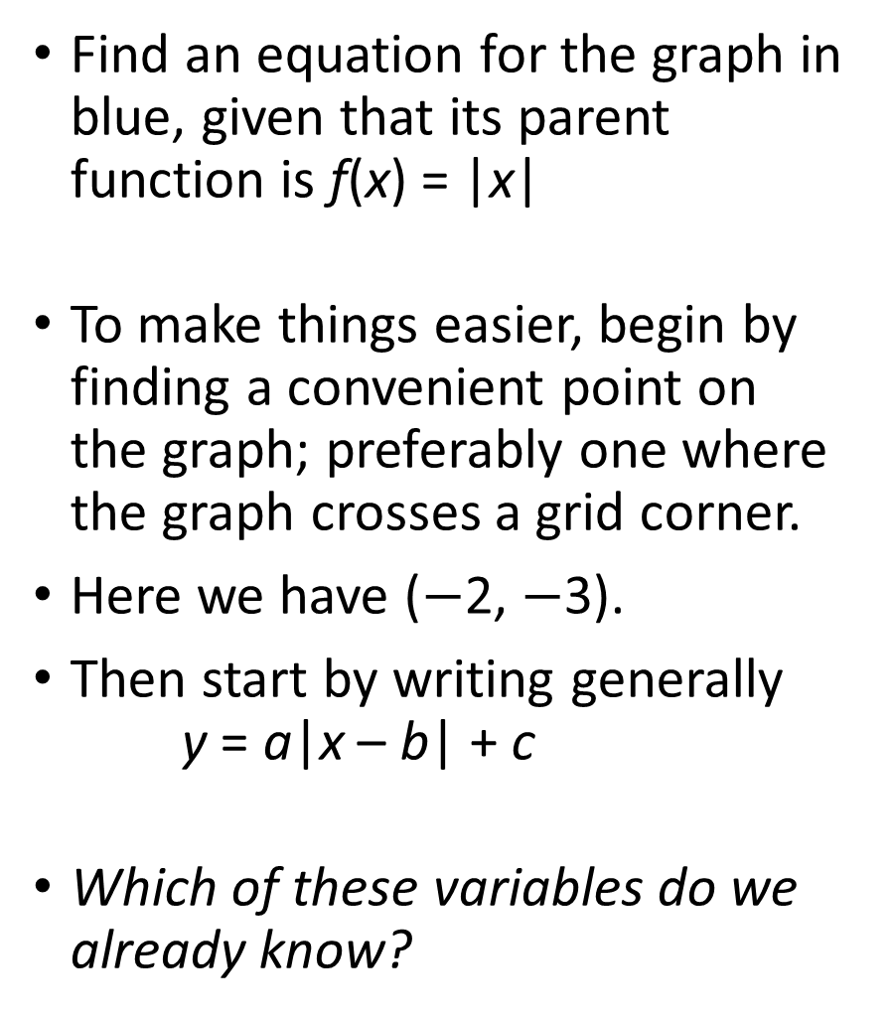
Examples
Find an equation for the graph in blue, given that its parent function is f(x) = |x|
To make things easier, begin by finding a convenient point on the graph; preferably one where the graph crosses a grid corner.
Here we have ($−$2, $−$3).
Then start by writing generally y = a|x – b| + c
Which of these variables do we already know?

Slide 25
Examples
Find an equation for the graph given that its parent function is f(x) = x²
Begin by picking a point that goes through a convenient point.
Here we have (1,0).
Write generally: y = a(x + b)² + c
Which variables do we already know?

Slide 26
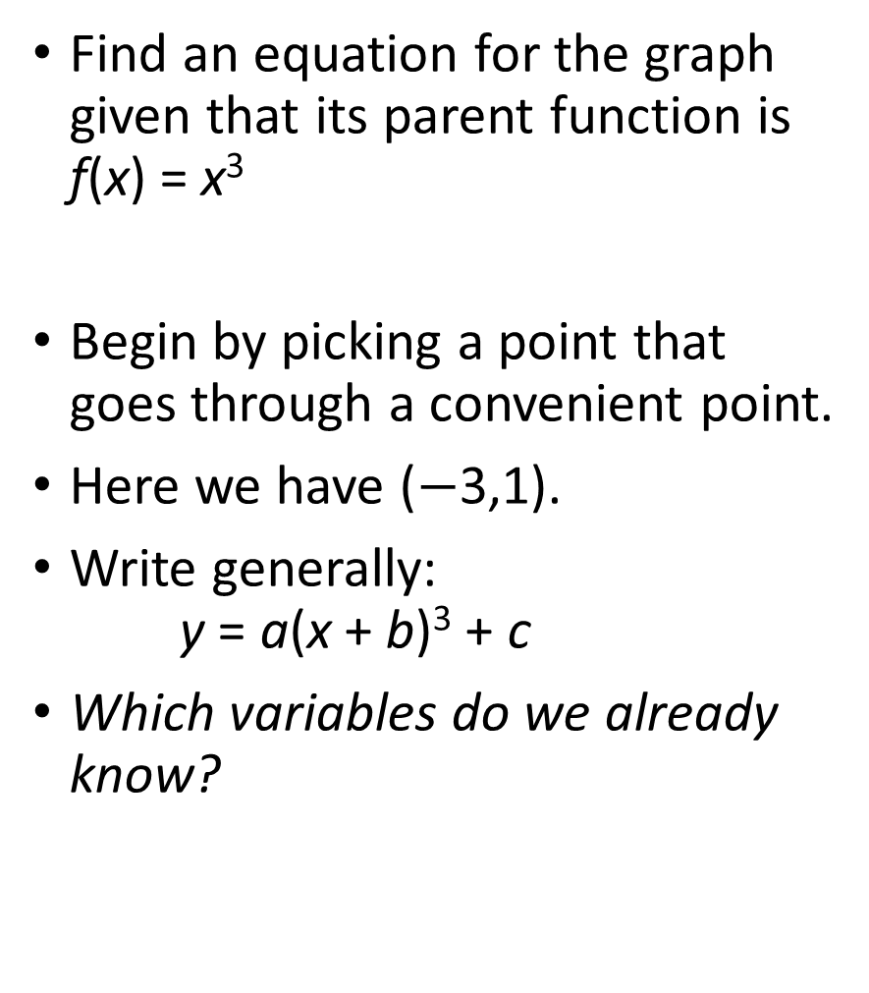
Examples
Find an equation for the graph given that its parent function is f(x) = x³
Begin by picking a point that goes through a convenient point.
Here we have ($−$3,1).
Write generally: y = a(x + b)³ + c
Which variables do we already know?

